Slide 1

splitting jericho

Slide 2
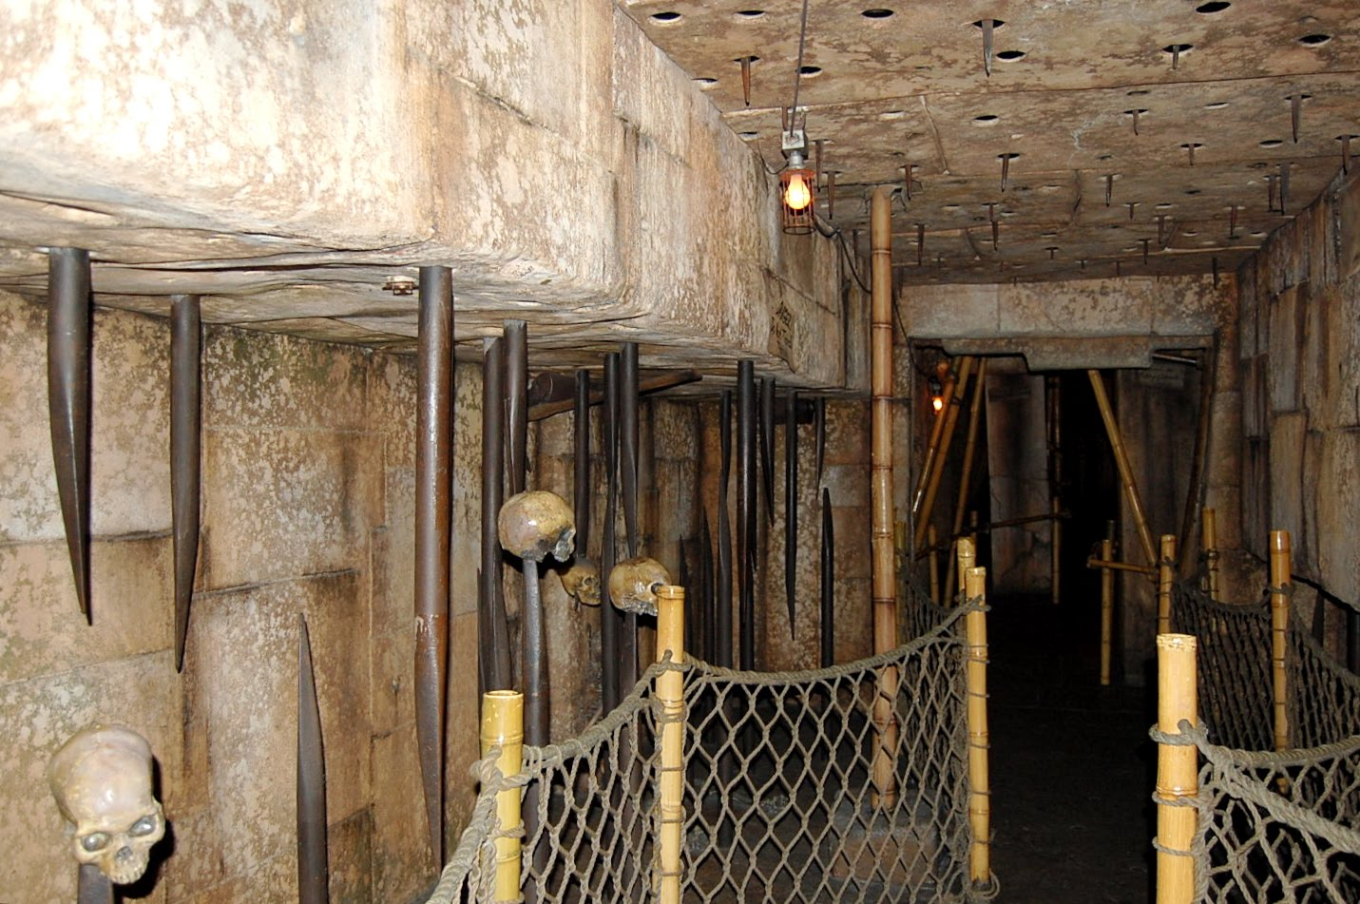
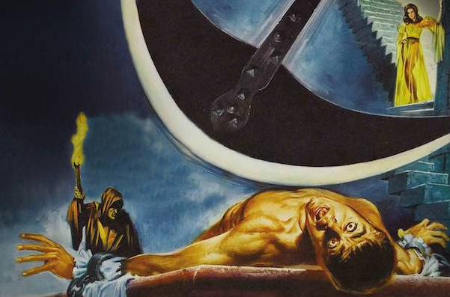
Indiana jones
poe

Slide 3
aka

Slide 4
a platformer with a twist
-(bob)(---
( )

Slide 5
gameplay

Slide 6





jacob
team hambam
rewant
greg
coco
lis

